Slide 1
CORE JAVA BASICS

Slide 2
Java – Overview
Java programming language was originally developed by Sun Microsystems which was initiated by James Gosling and released in 1995 as core component of Sun Microsystems' Java platform (Java 1.0 [J2SE]).
The latest release of the Java Standard Edition is Java SE 8. With the advancement of Java and its widespread popularity, multiple configurations were built to suit various types of platforms. For example: J2EE for Enterprise Applications, J2ME for Mobile Applications.
The new J2 versions were renamed as Java SE, Java EE, and Java ME
respectively. Java is guaranteed to be Write Once, Run Anywhere.

Slide 3

Java is:
Object Oriented: In Java, everything is an Object. Java can be easily extended since it is based on the Object model.
Platform Independent: Unlike many other programming languages including C and C++, when Java is compiled, it is not compiled into platform specific machine, rather into platform independent byte code. This byte code is distributed over the web and interpreted by the Virtual Machine (JVM) on whichever platform it is being run on.
Simple: Java is designed to be easy to learn. If you understand the basic concept of OOP Java, it would be easy to master.

Slide 4
Architecture-neutral: Java compiler generates an architecture-neutral object file format, which makes the compiled code executable on many processors, with the presence of Java runtime system.
Portable: Being architecture-neutral and having no implementation dependent aspects of the specification makes Java portable. Compiler in Java is written in ANSI C with a clean portability boundary, which is a POSIX subset.
Robust: Java makes an effort to eliminate error prone situations by emphasizing mainly on compile time error checking and runtime checking.
Multithreaded: With Java's multithreaded feature it is possible to write programs that can perform many tasks simultaneously. This design feature allows the developers to construct interactive applications that can run smoothly.
Interpreted: Java byte code is translated on the fly to native machine instructions and is not stored anywhere.
The development process is more rapid and analytical since the linking is an incremental and light-weight process.
High Performance: With the use of Just-In-Time compilers, Java enables high performance.

Slide 5
Distributed: Java is designed for the distributed environment of the internet.
Dynamic: Java is considered to be more dynamic than C or C++ since it is designed to adapt to an evolving environment. Java programs can carry extensive amount of run-time information that can be used to verify and resolve accesses to objects on run-time.

Slide 6
Java - Environment Setup
Assuming you have installed Java in c:\Program Files\java\jdk directory:
Right-click on 'My Computer' and select 'Properties‘→ Advanced System Settings.
Click the 'Environment variables' button under the 'Advanced' tab.
Now, alter the 'Path' variable so that it also contains the path to the Java executable.
Example, if the path is currently set to 'C:\WINDOWS\SYSTEM32', then update
your path to read 'C:\WINDOWS\SYSTEM32;c:\Program Files\java\jdk\bin'.

Slide 7
Java – Basic Syntax
When we consider a Java program, it can be defined as a collection of objects that communicate via invoking each other's methods.
Object - Objects have states and behaviors. Example: A dog has states - color, name, breed as well as behavior such as wagging their tail, barking, eating. An object is an instance of a class.
Class - A class can be defined as a template/blueprint that describes the behavior/state that the object of its type supports.
Methods - A method is basically a behavior. A class can contain many methods. It is in methods where the logics are written, data is manipulated and all the actions are executed.

Slide 8
First Java Program
– Save the file as: MyFirstJavaProgram.java.
public class MyFirstJavaProgram {
/* This is my first java program.
* This will print 'Hello World' as the output
*/
public static void main(String []args) { System.out.println("Hello World"); // prints Hello World
}
}

Slide 9
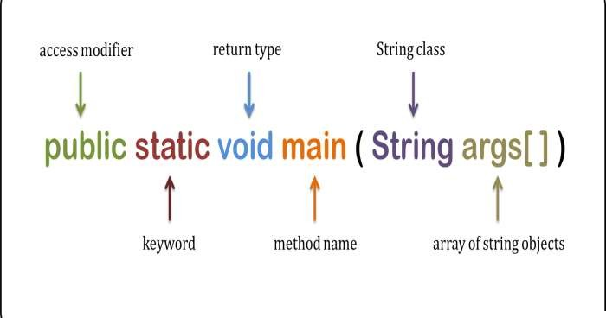

Slide 10
Program Execution
Compile Java Program From Command Prompt
C:\> javac MyFirstJavaProgram.java
C:\> java MyFirstJavaProgram O/P: Hello World
Compilation and execution of a Java program is two step process. During compilation phase Java compiler compiles the source code and generates bytecode. This intermediate bytecode is saved in form of a .class file. In second phase, Java virtual machine (JVM) also called Java interpreter takes the .class as input and generates output by executing the bytecode

Slide 11
Difference between JDK, JRE and JVM
JVM
JVM (Java Virtual Machine) is an abstract machine. It is a specification that provides runtime environment in which java bytecode can be executed.
JVMs are available for many hardware and software platforms. JVM, JRE and JDK are platform
dependent because configuration of each OS differs. But, Java is platform independent.
The JVM performs following main tasks:
Loads code
Verifies code
Executes code
Provides runtime environment

Slide 12
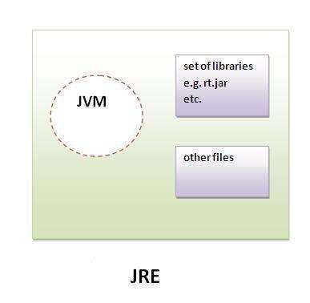
JRE
JRE is an acronym for Java Runtime Environment.It is used to provide runtime environment.It is the implementation of JVM. It physically exists. It contains set of libraries + other files that JVM uses at runtime.

Slide 13
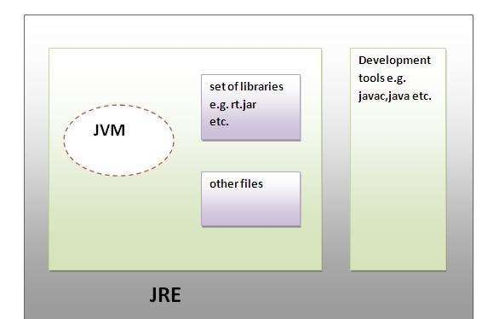
JDK
JDK is an acronym for Java Development Kit.It physically exists.It contains JRE + development tools.

Slide 14
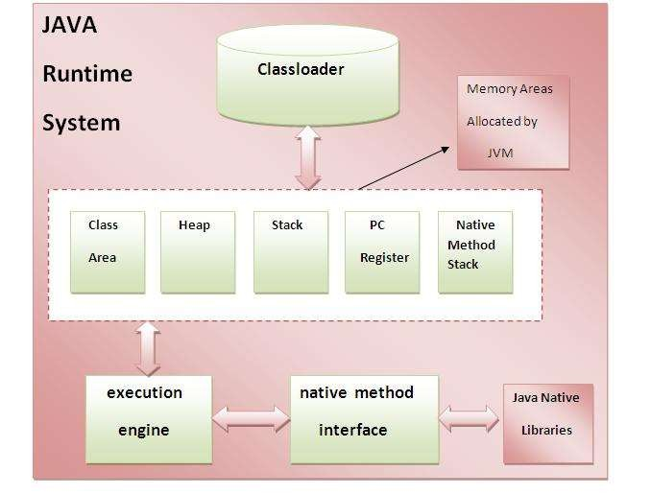
Internal Architecture of JVM

Slide 15
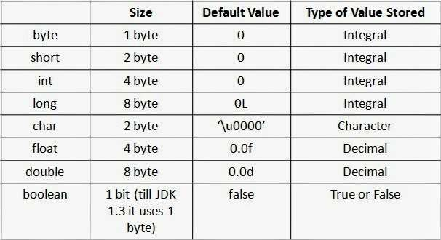
Primitive Data types
– There are eight primitive data types supported by Java.

Slide 16
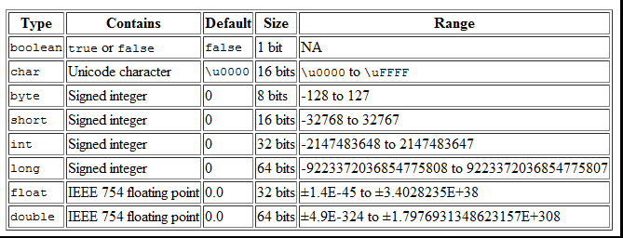

Slide 17
byte
byte:
This can hold whole number between -128 and 127. Mostly used to save memory and when you are certain that the numbers would be in the limit specified by byte data type.
Default size of this data type: 1 byte. Default value: 0

Slide 18
class JavaExample {
public static void main(String[] args) {
–
–
–
–
– }
– }
byte num; num = 113;
System.out.println(num);

Slide 19
short
short:
This is greater than byte in terms of size and less than integer. Its range is - 32,768 to 32767.
Default size of this data type: 2 byte

Slide 20
class JavaExample {
public static void main(String[] args) {
–
–
–
– }
– }
short num = 45678;; System.out.println(num);

Slide 21
int
– int: Used when short is not large enough to hold the number, it has a wider range: -2,147,483,648 to 2,147,483,647
Default size: 4 byte Default value: 0 Example:

Slide 22
class JavaExample {
public static void main(String[] args) {
–
–
–
– }
– }
int num = 45678;; System.out.println(num);

Slide 23
long:
– Used when int is not large enough to hold the value, it has wider range than int data type, ranging from -9,223,372,036,854,775,808 to 9,223,372,036,854,775,807.
size: 8 bytes
Default value: 0 Example:

Slide 24
class JavaExample {
public static void main(String[] args) {
–
–
–
– }
– }
long num = -12332252626L; System.out.println(num);

Slide 25
double
– double: Sufficient for holding 15 decimal digits size: 8 bytes
Example:

Slide 26
class JavaExample {
public static void main(String[] args) {
– double num = 42937737.93;
System.out.println(num);
– }
– }

Slide 27
float
– float: Sufficient for holding 6 to 7 decimal digits size: 4 bytes

Slide 28
class JavaExample {
public static void main(String[] args) {
–
–
–
– }
– }
float num = 19.98f; System.out.println(num);

Slide 29
boolean
boolean: holds either true of false.
class JavaExample {
public static void main(String[] args) {
–
–
–
– }
– }
boolean b = false; System.out.println(b);

Slide 30
char
char: holds characters. size: 2 bytes
class JavaExample {
public static void main(String[] args) {
–
–
–
– }
– }
char ch = 'a'; System.out.println(ch);

Slide 31
Numeric promotion
– byte->short->int->long->float->double

Slide 32
OOPs (Object Oriented Programming System)
Object-oriented programming System(OOPs) is a programming paradigm based on the concept of “objects” that contain data and methods. The primary purpose of object- oriented programming is to increase the flexibility and maintainability of programs. Object oriented programming brings together data and its behaviour(methods) in a single location(object) makes it easier to understand how a program works. We will cover each and every feature of OOPs in detail so that you won’t face any difficultly understanding OOPs Concepts.

Slide 33
OOPs Concepts
What is an Object
What is a class
Constructor in Java
Object Oriented Programming Features
Abstraction
Encapsulation
Inheritance
Polymorphism
Abstract Class and Methods
Interfaces in Java

Slide 34
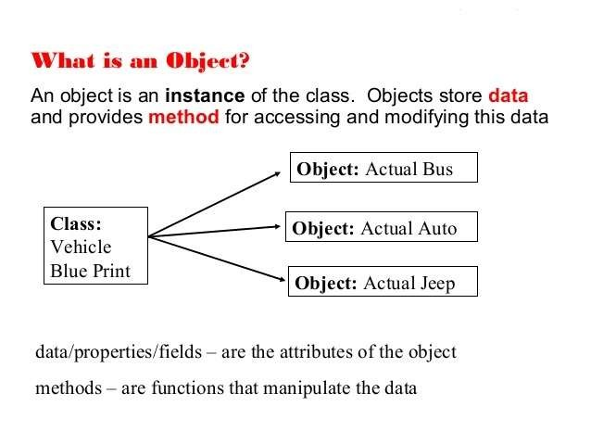
What is an Object

Slide 35
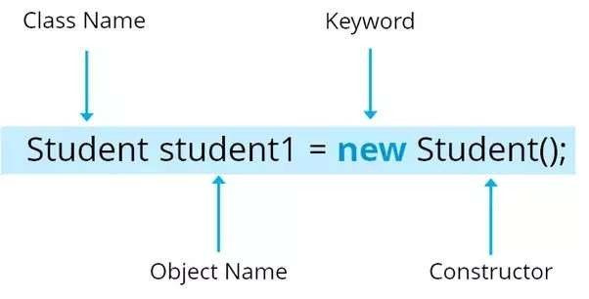

Slide 36
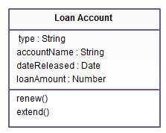
What is a class
A class is a template or blueprint that is used to create objects.
Class representation of objects and the sets of operations that can be applied to such objects.
Class consists of Data members and methods.
Primary purpose of a class is to held data/information. This is achieved with attributes which is also
known as data members.
Example:

Slide 37
– A class in Java can contain:
fields
Constructors
static blocks
Methods
instances

Slide 38
Example of class
– public class MyFirstJavaExample{ int a;
int b;
–
–
–
public int add() {
//Write code here
–
}
– public int sub() {
–
//Write code here
– }
– ...
– ...
– }

Slide 39
Syntax to declare a class
class <class_name> { field;
method;
}

Slide 40
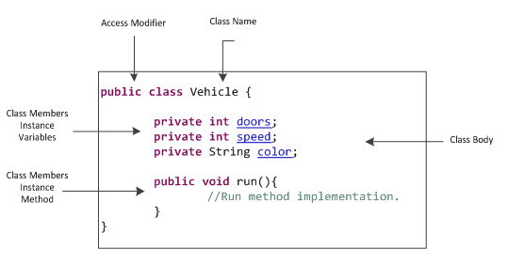

Slide 41
Basic Syntax
About Java programs, it is very important to keep in mind the following points.
Case Sensitivity - Java is case sensitive, which means identifier Hello and hello would have different meaning in Java.
Class Names - For all class names the first letter should be in Upper Case. If several words are used to form a name of the class, each inner word's first letter should be in Upper Case.
Example: class MyFirstJavaClass
Method Names - All method names should start with a Lower Case letter. If several words are used to form the name of the method, then each inner word's first letter should be in Upper Case.
Example: public void myMethodName()
Program File Name - Name of the program file should exactly match the class name. When saving the file, you should save it using the class name (Remember Java is case sensitive) and append '.java' to the end of the name (if the file name and the class name do not match, your program will not compile). Example: Assume 'MyFirstJavaProgram' is the class name. Then the file should be saved as 'MyFirstJavaProgram.java'

Slide 42
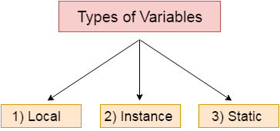
Types of Variable
– There are three types of variables in java:
local variable
instance variable
static variable

Slide 43
Local variables: Variables defined inside methods, constructors or blocks are called local variables. The variable will be declared and initialized within the method and the variable will be destroyed when the method has completed.
Instance variables: Instance variables are variables within a class but outside any method. These variables are initialized when the class is instantiated. Instance variables can be accessed from inside any method, constructor or blocks of that particular class.

Slide 44
Class variables: Class variables are variables declared within a class, outside any method, with the static keyword.
class A{
int data=50;//instance variable
static int m=100;//static variable
void method(){
int n=90;//local variable
– }
}//end of class

Slide 45
Java Language Keywords
– Here is a list of keywords in the Java programming language. You cannot use any of the following as identifiers in your programs. The keywords const and goto are reserved, even though they are not currently used. true, false, and null might seem like keywords, but they are actually literals; you cannot use them as identifiers in your programs.

Slide 46
abstract assert*** boolean break byte case
continue default do double else
_{enum}****
for goto* if
implements import instanceof
new package private protected public
switch synchronized this
throw throws transient
*
return
not used
catch | extends | int | short | try
char | final | interface | static | void
class | finally | long | strictfp** | volatile
const* | float | native | super | while

Slide 47
Constructor in Java
Constructor in java is a special type of method that is used to initialize the object.
Java constructor is invoked at the time of object creation. It constructs the values i.e. provides data for the object that is why it is known as constructor.

Slide 48
Rules for creating java constructor
– here are basically two rules defined for the constructor.
Constructor name must be same as its class name
Constructor must have no explicit return type

Slide 49
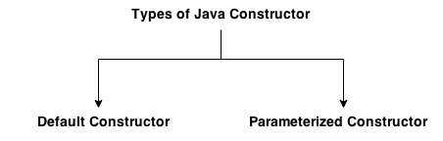
Types of java constructors
– There are two types of constructors:
Default constructor (no-arg constructor)
Parameterized constructor

Slide 50
package com.corejava.examples;
public class constructorExample {
constructorExample(){
System.out.println("inside 0 arg constroctor");
– }
constructorExample(int i){
System.out.println("inside 1 arg constroctor constroctor ::"+i);
– }
– }

Slide 51
Example1(){
– this(10);
System.out.println("in 0 argument constructor");
– }
Example1(int a){
System.out.println("in 1 argument constructor"+a);
– }

Slide 52
Difference between constructor and method in java
Java Constructor
Constructor is used to initialize the state of an object.
Constructor must not have return type. Constructor is invoked implicitly.
The java compiler provides a default constructor if you don't have any constructor.
Constructor name must be same as the class name.
Java Method
Method is used to expose behaviour of an object.
Method must have return type. Method is invoked explicitly.
Method is not provided by compiler in any case.
Method name may or may not be same as class name.

Slide 53
Java – Static Class, Block, Methods and Variables
– In a class we can have
static variables
static methods
static blocks of code.

Slide 54
static variables
It is a variable which belongs to the class and not to object(instance)
Static variables are initialized only once , at the start of the execution . These variables will be initialized first, before the initialization of any instance variables
A single copy to be shared by all instances of the class
A static variable can be accessed directly by the class name and doesn’t need any object
Syntax : <class-name>.<variable-name>

Slide 55
public class StaticExample {
static int num;
static String mystr;
static{
– num = 97;
–
mystr = "Static keyword in Java";
– }
public static void m1(){
System.out.println("in m1 methode");
– }

Slide 56
Static block
The static block, is a block of statement inside a Java class that will be executed when a class is first loaded in to the JVM
class Test{
static {
//Code goes here
– }
– }

Slide 57
public class StaticExample {
static int num;
static String mystr;
static{
– num = 97;
mystr = "Static keyword in Java";
– }
– }

Slide 58
Multiple Static blocks
class JavaExample2{
static int num;
static String mystr;
//First Static block
static{
System.out.println("Static Block 1");
– num = 68;
mystr = "Block1";
– }

Slide 59
//Second static block
static{
System.out.println("Static Block 2");
– num = 98;
mystr = "Block2";
– }
// System.out.println("Value of num: "+num); o/p :Static Block2,98,block2
// System.out.println("Value of mystr: "+mystr);

Slide 60
Different types of methods in java
static methods
Non-static methods/instance methods
Public Class StaticExp{ public static void add(){
}
}

Slide 61
Java Static Method
It is a method which belongs to the class and not to the object(instance)
A static method can access only static data. It can not access non-static data (instance variables)
A static method can call only other static methods and can not call a non-static method from it.
A static method can be accessed directly by the class name and doesn’t need any object
Syntax : <class-name>.<method-name>
A static method cannot refer to "this" or "super" keywords in anyway

Slide 62
Instance methods
Methods and variables that are not declared as static are known as instance methods and instance variables. To refer to instance methods and variables, you must instantiate the class first means you should create an object of that class first.For static you don't need to instantiate the class u can access the methods and variables with the class name
Example
Public Class Persion{
Public void add(){
– }
– }

Slide 63
Person person1 = new Person(); //instantiating
person1.add(); //accessing non-static method.

Slide 64
Inheritance in Java
Inheritance in java is a mechanism in which one object acquires all the properties and behaviors of parent object.
The idea behind inheritance in java is that you can create new classes that are built upon existing classes. When you inherit from an existing class, you can reuse methods and fields of parent class, and you can add new methods and fields also.
Inheritance represents the IS-A relationship, also known as parent-child
relationship

Slide 65
Types of Inheritance
1)Single
2)Multilevel
3)Hierarchical
4)Multiple
5)Hybrid

Slide 66
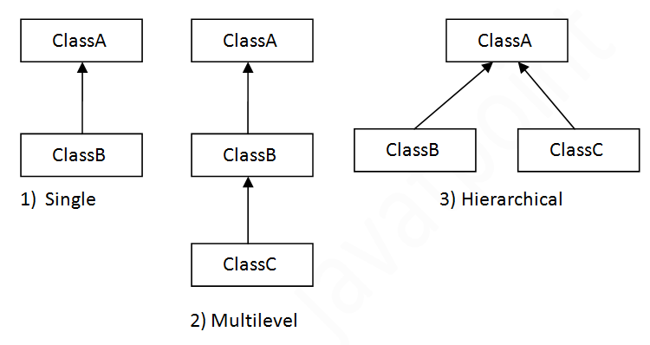

Slide 67
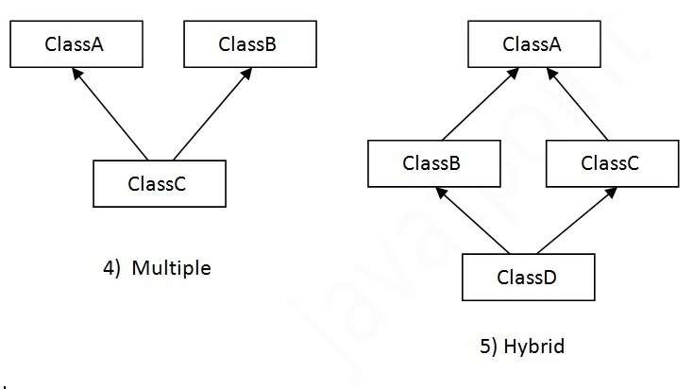
JAVA will not support Multiple,Hybrid In inheritance

Slide 68
Syntax of Java Inheritance
class Subclass-name extends Superclass-name
– {
//methods and fields
– }

Slide 69
Why multiple inheritance is not supported in java?
To reduce the complexity and simplify the language, multiple inheritance is not supported in java.
Consider a scenario where A, B and C are three classes. The C class inherits A and B classes. If A and B classes have same method and you call it from child class object, there will be ambiguity to call method of A or B class.
Since compile time errors are better than runtime errors, java renders compile time error if you inherit 2 classes. So whether you have same method or different, there will be compile time error now.

Slide 70
class A{
void msg(){System.out.println("Hello");}
•}
class B{
void msg(){System.out.println("Welcome");}
•}

Slide 71
class C extends A,B{//suppose if it were
•
Public Static void main(String args[]){
C obj=new C();
obj.msg();//Now which msg() method would be invoked?
•}
•}

Slide 72
This keyword in java
– There can be a lot of usage of java this keyword. In java, this is a reference variable that refers to the current object.

Slide 73
Usage of java this keyword
Here is given the 6 usage of java this keyword.
this can be used to refer current class instance variable.
this can be used to invoke current class method (implicitly)
this() can be used to invoke current class constructor.
this can be passed as an argument in the method call.
this can be passed as argument in the constructor call.
this can be used to return the current class instance from the method.

Slide 74
this: to refer current class instance variable
– The this keyword can be used to refer current class instance variable. If there is ambiguity between the instance variables and parameters, this keyword resolves the problem of ambiguity

Slide 75
Understanding the problem without this keyword
class Student{
int rollno;
String name;
float fee;
Student(int rollno,String name,float fee){
rollno=rollno;
name=name;
fee=fee;
– }

Slide 76
void display(){System.out.println(rollno+" "+name+" "+fee);}
– }
class TestThis1{
public static void main(String args[]){
Student s1=new Student(111,"ankit",5000f);
Student s2=new Student(112,"sumit",6000f);
s1.display();
s2.display();
– }}

Slide 77
Solution of the above problem by this keyword
class Student{
int rollno;
String name;
float fee;
Student(int rollno,String name,float fee){
this.rollno=rollno;
this.name=name;
this.fee=fee;
– }
void display(){System.out.println(rollno+" "+name+" "+fee);}
– }

Slide 78
this: to invoke current class method
– You may invoke the method of the current class by using the this keyword. If you don't use the this keyword, compiler automatically adds this keyword while invoking the method. Let's see the example

Slide 79
class A{
void m(){System.out.println("hello m");}
void n(){
System.out.println("hello n");
//m();//same as this.m()
this.m();
– }
– }

Slide 80
this() : to invoke current class constructor
– The this() constructor call can be used to invoke the current class constructor. It is used to reuse the constructor. In other words, it is used for constructor chaining.

Slide 81
class A{
A(){System.out.println("hello a");}
A(int x){
this();
System.out.println(x);
– }
– }
P s v main(String args[]){A a=new A(10); }

Slide 82
Call to this() must be the first statement in constructor
Student(){ //wrong example
System.out.println(“in 0 args constructor”)
– }
Student(int a){
System.out.println(“in 0 args constructor”)
this();//C.T.Error
– }

Slide 83
Student(){ //correct example
System.out.println(“in 0 args constructor”)
– }
Student(int a){
this(); //this should in first line
System.out.println(“in 0 args constructor”)
–
– }

Slide 84
this keyword can be used to return current class instance
We can return this keyword as an statement from the method. In such case, return type of the method must be the class type (non-primitive). Let's see the example:
return_type method_name(){
return this;
– }

Slide 85
public class Example2 {
public Example2 xyz1(){
System.out.println("from xyz1 methode "+this);
return this;
– }
– }

Slide 86
public class Test345 {
public static void main(String[] args) {
// TODO Auto-generated method stub
Example2 example2=new Example2();
– System.out.println("------------->>>"+example2);
example2. xyz1();
– }

Slide 87
super keyword in java
The super keyword in java is a reference variable which is used to refer immediate parent class object.
Whenever you create the instance of subclass, an instance of parent class is created implicitly which is referred by super reference variable.

Slide 88
Usage of java super Keyword
super can be used to refer immediate parent class instance variable.
super can be used to invoke immediate parent class method.
super() can be used to invoke immediate parent class constructor.

Slide 89
super is used to refer immediate parent class instance variable
class A {
String color="white";
– }
class B extends A{
String color="black";
void printColor(){
System.out.println(color);
System.out.println(super.color);
– }
– }

Slide 90
super can be used to invoke parent class method
class A {
void M1(){System.out.println("insuper M1..");}
– }
class B extends A{
void M1(){System.out.println(" in subM1..");}
void M1(){System.out.println(" in subM2..");}
void C(){
super.m1();
–
–
–
}
}

Slide 91
class TestSuper2{
public static void main(String args[]){
B b=new B();
– b.C();
– }}

Slide 92
super is used to invoke parent class constructor
class A {
A(){System.out.println("in M1..");}
– }
class B extends A{
super();
B() {System.out.println("in M1..");}
–
–
–
–
}
}

Slide 93
class TestSuper2{
public static void main(String args[]){
B b=new B();
–
– }}
super() is added in each class constructor automatically by compiler if there is
no super() or this().

Slide 94
Final Keyword In Java
The final keyword in java is used to restrict the user. The java final keyword can be used in many context. Final can be:
variable
method
class

Slide 95
Java final variable example
class A{
final int a=90;//final variable
void m1(){
– a=400;
– }
public static void main(String args[]){
A obj=new A();
– obj.m1();
– }
}//end of class //compalation error

Slide 96
– If you make any variable as final, you cannot change the value of final variable(It will be constant).

Slide 97
Java final method
If you make any method as final, you cannot override it.
class A{
final public void m1()
– }
class B extends A{
public void m2()
– }

Slide 98
Java final class
If you make any class as final, you cannot extend it
final class A{
final public void m1()
– }
class B extends A{
public void m2()
} Output:Compile Time Error

Slide 99
Polymorphism
– Polymorphism is one of the OOPs feature that allows us to perform a single action in different ways. For example, lets say we have a class Animal that has a method sound(). Since this is a generic class so we can’t give it a implementation like: Roar, Meow, Oink etc. We had to give a generic message

Slide 100
Method Overloading in Java
– If a class has multiple methods having same name but different in parameters, it is known as Method Overloading.

Slide 101
If we have to perform only one operation, having same name of the methods increases the readability of the program.
Suppose you have to perform addition of the given numbers but there can be any number of arguments, if you write the method such as a(int,int) for two parameters, and b(int,int,int) for three parameters then it may be difficult for you as well as other programmers to understand the behavior of the method because its name differs.
So, we perform method overloading to figure out the program quickly.

Slide 102
Advantage of method overloading
Method overloading increases the readability of the program.
Example
void add(int a)
void add(int a,int b)
void add(int a,int b,int c)

Slide 103
Different ways to overload the method
There are two ways to overload the method in java
By changing number of arguments
By changing the data type
In java, Method Overloading is not possible by changing the return type of the method only

Slide 104
Method Overloading: changing no. of arguments
class Add{
static int add(int a,int b){return a+b;}
static int add(int a,int b,int c){return a+b+c;}
– }
class TestOverloading1{
public static void main(String[] args){
System.out.println(Add.add(11,11));
System.out.println(Add.add(11,11,11));
– }}

Slide 105
Method Overloading: changing data type of arguments
class Add{
static int add(int a, int b){return a+b;}
static double add(double a, double b){return a+b;}
– }

Slide 106
Why Method Overloading is not possible by changing the return type of method only
– In java, method overloading is not possible by changing the return type of the method only because of ambiguity

Slide 107
class Adder{
static int add(int a,int b){return a+b;}
static double add(int a,int b){return a+b;}
– }

Slide 108
Method Overriding in Java
If subclass (child class) has the same method as declared in the parent class, it is known as method overriding in java.
In other words, If subclass provides the specific implementation of the method that has been provided by one of its parent class, it is known as method overriding.

Slide 109
Usage of Java Method Overriding
Method overriding is used to provide specific implementation of a method that is already provided by its super class.
Method overriding is used for runtime polymorphism

Slide 110
Rules for Java Method Overriding
method must have same name as in the parent class
method must have same parameter as in the parent class.
must be IS-A relationship (inheritance).

Slide 111
Example of method overriding
class A {
void m1(){System.out.println(“from class A m1 method");}
– }
class B extends A{
void m1 (){System.out.println(" from class B m1 method ");}

Slide 112
Encapsulation
– Encapsulation simply means binding object state(fields) and behaviour(methods) together. If you are creating class, you are doing encapsulation

Slide 113
What is encapsulation?
The whole idea behind encapsulation is to hide the implementation details from users. If a data member is private it means it can only be accessed within the same class. No outside class can access private data member (variable) of other class.
However if we setup public getter and setter methods to update (for example void setEmpId(int empId))and read (for example int getEmpId()) the private data fields then the outside class can access those private data fields via public methods.

Slide 114
Example of Encapsulation in Java
class EncapsulationDemo{
private String empName;
private int empAge;
public String getEmpName(){
return empName;
– }
public String getEmpName(){
return empName;
– }}

Slide 115
public class EncapsTest{
public static void main(String args[]){
EncapsulationDemo obj = new EncapsulationDemo();
obj.setEmpName(“xyz");
obj.setEmpAge(10);
System.out.println("Employee Name: " + obj.getEmpName());
System.out.println("Employee Age: " + obj.getEmpAge());
– }
– }

Slide 116
Advantage of Encapsulation in java
By providing only setter or getter method, you can make the class read-only or write-only
It improves maintainability and flexibility and re-usability
User would not be knowing what is going on behind the scene. They would only be knowing that to update a field call set method and to read a field call get method but what these set and get methods are doing is purely hidden from them.

Slide 117
Simple example of encapsulation in java
package com.demo;
public class Student{
private String name;
–
public String getName(){
return name;
– }
public void setName(String name){
this.name=name
– }
– }

Slide 118
//save as Test.java
package com.demo;
class Test{
public static void main(String[] args){
Student s=new Student();
s.setName(“xyz");
System.out.println(s.getName());
– }
– }

Slide 119
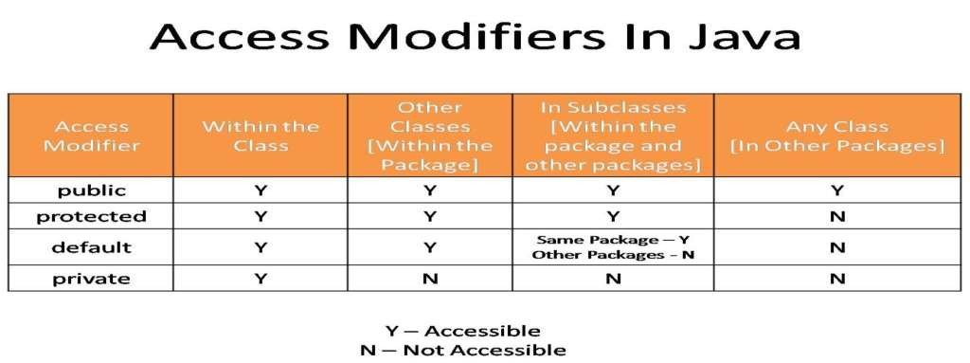

Slide 120
Abstraction
Abstraction is a process of hiding the implementation details and showing only functionality to the user.
Another way, it shows only important things to the user and hides the internal details for example sending sms, you just type the text and send the message. You don't know the internal processing about the message delivery.
Abstraction lets you focus on what the object does instead of how it does it.

Slide 121
Ways to achieve Abstraction
There are two ways to achieve abstraction in java
Abstract class (0 to 100%)
Interface (100%)

Slide 122
Interface
– Interface looks like a class but it is not a class. An interface can have methods and variables just like the class but the methods declared in interface are by default abstract (only method signature, no body). Also, the variables declared in an interface are public, static & final by default

Slide 123
What is the use of interface in Java
– As mentioned above they are used for full abstraction. Since methods in interfaces do not have body, they have to be implemented by the class before you can access them. The class that implements interface must implement all the methods of that interface. Also, java programming language does not allow you to extend more than one class, However you can implement more than one interfaces in your class

Slide 124
Syntax:
interface MyInterface
– {
//All the methods are public abstract by default
–
public void method1();
public void method2();
– }

Slide 125
how a class implements an interface
– It has to provide the body of all the methods that are declared in interface or in other words you can say that class has to implement all the methods of interface.

Slide 126
interface MyInterface
– {
public void method1();
public void method2();
– }

Slide 127
class Demo implements MyInterface
– {
public void method1()
{ System.out.println("implementation of method1");
– }
public void method2()
{System.out.println("implementation of method2");
– }
public static void main(String arg[])
{ MyInterface obj = new Demo();
obj.method1(); } }

Slide 128
Variables declared in interface
are public, static and final by default
interface MyInterface
– {
int a=10;
public void method1();
– }
Interface variables must be initialized at the time of declaration otherwise
compiler will throw an error.

Slide 129
Advantages of interface in java:
Without bothering about the implementation part, we can achieve the security of implementation
In java, multiple inheritance is not allowed, however you can use interface to make use of it as you can implement more than one interface.

Slide 130
Abstract Class
– A class that is declared using “abstract” keyword is known as abstract class. It can have abstract methods(methods without body) as well as concrete methods (regular methods with body). A normal class(non-abstract class) cannot have abstract methods

Slide 131
Abstract class declaration
//Declaration using abstract keyword
abstract class A{
//This is abstract method
abstract void myMethod();
//This is concrete method with body
void anotherMethod(){
//Does something
– }
– }

Slide 132
As we seen in the above example, there are cases when it is difficult or often unnecessary to implement all the methods in parent class. In these cases, we can declare the parent class as abstract, which makes it a special class which is not complete on its own
Abstract class cannot be instantiated which means you cannot create the object of it. To use this class, you need to create another class that extends this this class and provides the implementation of abstract methods, then you can use the object of that child class to call non-abstract methods of parent class as well as implemented methods(those that were abstract in parent but implemented in child class).

Slide 133
– If a child does not implement all the abstract methods of abstract parent class, then the child class must need to be declared abstract as well

Slide 134
Why can’t we create the object of an abstract class?
Because these classes are incomplete, they have abstract methods that have no body
so if java allows you to create object of this class then if someone calls the abstract method using that object then What would happen?There would be no actual implementation of the method to invoke.
Also because an object is concrete. An abstract class is like a template, so you have to extend it and build on it before you can use it

Slide 135
Abstract class Example
abstract class AbstractDemo{
public void myMethod(){
System.out.println("Hello");
– }
abstract public void anotherMethod();
– }
public class Demo extends AbstractDemo{
public void anotherMethod() {
System.out.print("Abstract method");
– }

Slide 136
public static void main(String args[])
– {
Demo obj = new Demo();
obj.anotherMethod();
– }

Slide 137
Java Collections Framework

Slide 138
Overview of Java Collections
The Java Collections API's provide Java developers with a set of classes and interfaces that makes it easier to handle collections of objects. In a sense Collection's works a bit like arrays, except their size can change dynamically, and they have more advanced behaviour than arrays.
Rather than having to write your own collection classes, Java provides these ready-to-use
collection classes for you.

Slide 139
Collection is an object representing a group of objects.
Collection framework contains a set of classes and interfaces which are used for representing and manipulating collections.
Collection interface is the root interface from which the interfaces List, Set,Queue are extended.
The java.util package contains all the classes and interfaces for Collection framework

Slide 140
Collections in java is a framework that provides an architecture to store and manipulate the group of objects.
All the operations that you perform on a data such as searching, sorting, insertion, manipulation, deletion etc. can be performed by Java Collections.
Java Collection simply means a single unit of objects. Java Collection framework provides many interfaces (Set, List, Queue, Deque etc.) and classes (ArrayList, Vector, LinkedList, PriorityQueue, HashSet, LinkedHashSet, TreeSet etc).

Slide 141
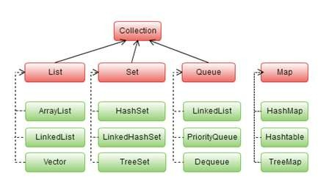

Slide 142
List interface:
List interface is an ordered collection in which duplicate elements are also allowed.
Elements are stored in a sequential way and hence its elements can be accessed using the index value.
ArrayList (C)
LinkedList (C)
Vector (C)

Slide 143
Java Non-generic Vs Generic Collection
Java collection framework was non-generic before JDK 1.5. Since 1.5, it is generic.
Java new generic collection allows you to have only one type of object in collection. Now it is type safe so typecasting is not required at run time.

Slide 144

Methods of Java List Interface
Method | Description
void add(int index,Object element) | It is used to insert element into the invoking list at the index passed in the index.
boolean addAll(int index,Collection c) | It is used to insert all elements of c into the invoking list at the index passed in the index.
object get(int index) | It is used to return the object stored at the specified index within the invoking collection.
object set(int index,Object element) | It is used to assign element to the location specified by index within the invoking list.
object remove(int index) | It is used to remove the element at position index from the invoking list and return the deleted element.
ListIterator listIterator() | It is used to return an iterator to the start of the invoking list.
ListIterator listIterator(int index) | It is used to return an iterator to the invoking list that begins at the specified index.

Slide 145
Java List Interface
List Interface is the subinterface of Collection.It contains methods to insert and delete elements in index basis.It is a factory of ListIterator interface
public interface List<E> extends Collection<E>

Slide 146
Set interface:
Set is an unordered collection. It does not maintain any order while storing the elements. It does not allow duplicate elements.
Thus if one requires to store a group of unique elements, set can be used.
HashSet (C)
LinkedHashSet (C)
TreeSet (C)

Slide 147
Set is an interface which extends Collection. It is an unordered collection of objects in which duplicate values cannot be stored.
Basically, Set is implemented by HashSet, LinkedSet or TreeSet (sorted representation).
Set has various methods to add, remove clear, size, etc to enhance the usage of this interface

Slide 148
Map interface:
Map is an interface which maps keys to values in which each key has to be unique.
HashMap (C)
Hashtable (C)
TreeMap (C)

Slide 149
Iterator interface
Iterator interface:
Iterator interface is used to iterate over a collection object and retrieve the elements one after the other

Slide 150
ListIterator interface
ListIterator interface:
ListIterator is similar to Iterator interface except that the elements of the collection can be retrieved from both forward and backward direction.

Slide 151
Enumeration interface
Enumeration interface
Enumeration interface is similar to Iterator interface except that it cannot remove elements and can only iterate over the collection object

Slide 152
Iterating using enhanced for loop
Enhanced for loop can also be used to iterate over the collection object.
List<String> places= new LinkedList<String>();
for(String place: places)
System.out.println(“Place:”+place);

Slide 153
ArrayList
– Arraylist class implements List interface. It is widely used because of the functionality and flexibility it offers. Most of the developers choose Arraylist over
Array as it’s a very good alternative of traditional java arrays. ArrayList is a resizable-
array implementation of the List interface. It implements all optional list operations,
and permits all elements, including null.
– The issue with arrays is that they are of fixed length so if it is full you cannot add any more elements to it, likewise if there are number of elements gets removed from it the memory consumption would be the same as it doesn’t shrink. On the other ArrayList can dynamically grow and shrink after addition and removal of elements. Apart from these benefits ArrayList class enables us to use predefined methods of it which makes our task easy.

Slide 154
ArrayList class declaration
– public class ArrayList<E> extends AbstractList<E> implements List<E>, RandomA ccess, Cloneable, Serializable
Default Constructor
ArrayList al=new ArrayList() //default Capacity 10 It will Increases it’s Capacity by (CC*3/2)+1

Slide 155
Constructors of Java ArrayList
Constructor ArrayList()
Description
It is used to build an empty array list.
It is used to build an array list that is initialized with the elements of the collection c.
It is used to build an array list that has the specified initial capacity.
ArrayList(Collection c)
ArrayList(int capacity)

Slide 156
Methods of Java ArrayList
Method
Description
void add(int index, Object element)
It is used to insert the specified element at the specified position index in a list.
boolean addAll(Collection c)
It is used to append all of the elements in the specified collection to the end of this list, in the order that they are returned by the specified collection's iterator.
void clear()
It is used to remove all of the elements from this list.
int lastIndexOf(Object o)
It is used to return the index in this list of the last occurrence of the specified element, or -1 if the list does not contain this element.
Object[] toArray()
It is used to return an array containing all of the elements in this list in the correct order.
Object[] toArray(Object[] a)
It is used to return an array containing all of the elements in this list in the correct order.
boolean add(Object o)
It is used to append the specified element to the end of a list.
boolean addAll(int index, Collection c)
It is used to insert all of the elements in the specified collection into this list, starting at the specified position.
Object clone()
It is used to return a shallow copy of an ArrayList.
int indexOf(Object o)
It is used to return the index in this list of the first occurrence of the specified element, or -1 if the List does not contain this element.
void trimToSize()
It is used to trim the capacity of this ArrayList instance to be the list's current size.

Slide 157
ArrayList Example in Java
public class ArrayListDemo {
public static void main(String args[]) {
ArrayList<String> obj = new ArrayList<String>();
obj.add("xyz");
obj.add("pqr");
obj.add("xyz1");
obj.add("pqr2");
/* Displaying array list elements */
System.out.println("Currently the array list has following elements:"+obj);

Slide 158
Two ways to iterate the elements of collection in java
There are two ways to traverse collection elements:
By Iterator,ListIterator interfaces.
By for-each loop.

Slide 159
Using Iterator(I)
ArrayList<String> list=new ArrayList<String>();//Creating arraylist
list.add("Ravi");//Adding object in arraylist
list.add("Vijay");
list.add("Ravi");
list.add("Ajay");
//Traversing list through Iterator
Iterator itr=list.iterator();
while(itr.hasNext()){
System.out.println(itr.next());
}

Slide 160
Iterating Collection through for- each loop
import java.util.*;
class TestCollection2{
public static void main(String args[]){
ArrayList<String> al=new ArrayList<String>();
al.add("Ravi");
al.add("Vijay");
al.add("Ravi");
for(String obj:al) {
System.out.println(obj);
– } }

Slide 161
Java LinkedList class
Java LinkedList class uses doubly linked list to store the elements. It provides a linked-list data structure. It inherits the AbstractList class and implements List and Deque interfaces.
The important points about Java LinkedList are:
Java LinkedList class can contain duplicate elements.
Java LinkedList class maintains insertion order.
Java LinkedList class is non synchronized.
In Java LinkedList class, manipulation is fast because no shifting needs to be
occurred.
Java LinkedList class can be used as list, stack or queue

Slide 162


Slide 163
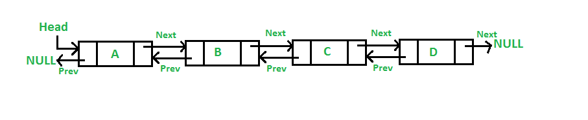

Slide 164
Constructors of Java LinkedList
Constructor LinkedList()
Description
It is used to construct an empty list.
It is used to construct a list containing the elements of the specified collection, in the order they are returned by the collection's iterator.
LinkedList(Collection c)

Slide 165
Methods of Java LinkedList
Method
Description
void add(int index, Object element)
It is used to insert the specified element at the specified position index in a list.
void addFirst(Object o)
It is used to insert the given element at the beginning of a list.
void addLast(Object o)
It is used to append the given element to the end of a list.
int size()
It is used to return the number of elements in a list
boolean add(Object o)
It is used to append the specified element to the end of a list.
boolean contains(Object o)
It is used to return true if the list contains a specified element.
boolean remove(Object o)
It is used to remove the first occurence of the specified element in a list.
Object getFirst() Object getLast()
It is used to return the first element in a list. It is used to return the last element in a list.
int indexOf(Object o)
It is used to return the index in a list of the first occurrence of the specified element, or -1 if the list does not contain any element.
int lastIndexOf(Object o)
It is used to return the index in a list of the last occurrence of the specified element, or -1 if the list does not contain any element.

Slide 166
Java LinkedList Example
import java.util.*;
public class LinkedListDemo{
public static void main(String args[]){
LinkedList<String> al=new LinkedList<String>();
al.add("Ravi");
al.add("Vijay");
al.add("Ravi");
al.add("Ajay");
–
–

Slide 167
Iterator<String> itr=al.iterator();
while(itr.hasNext()){
System.out.println(itr.next());
– }
– }
– }

Slide 168
Vector in Java
– Vector implements List Interface. Like ArrayList it also maintains insertion order but it is rarely used in non-thread environment as it is synchronized and due to which it gives poor performance in searching, adding, delete and update of its elements.

Slide 169
ways to create vector class object
Syntax: -1)Vector vec = new Vector();
– It creates an empty Vector with the default initial capacity of 10. It means the Vector will be re-sized when the 11th elements needs to be inserted into the Vector. Note: By default vector doubles its size. i.e. In this case the Vector size would remain 10 till 10 insertions and once we try to insert the 11th element It would become 20 (double of default capacity 10).

Slide 170
Syntax: - 2) : Vector object= new Vector(int initialCapacity)
Exp
Vector vec = new Vector(3);
Syntax:
Syntax: -3) Vector object= new vector(int initialcapacity, capacityIncrement)

Slide 171
Example:
Vector vec= new Vector(4, 6)
Here we have provided two arguments. The initial capacity is 4 and capacityIncrement is 6. It means upon insertion of 5th element the size would be 10 (4+6) and on 11th insertion it would be 16(10+6).
Syntax: -4) Vector object= new Vector(Collection c)

Slide 172
public class VectorExample {
public static void main(String args[]) {
Vector<String> vec = new Vector<String>(2);
vec.addElement("A");
vec.addElement("B");
vec.addElement("C");
vec.addElement("D");
– }

Slide 173
Commonly used methods of Vector Class:
void addElement(Object element): It inserts the element at the end of the Vector.
int capacity(): This method returns the current capacity of the vector.
int size(): It returns the current size of the vector.
void setSize(int size): It changes the existing size with the specified size.
boolean contains(Object element): This method checks whether the specified element is present in the Vector. If the element is been found it returns true else false.

Slide 174
boolean containsAll(Collection c): It returns true if all the elements of collection c are present in the Vector.
Object elementAt(int index): It returns the element present at the specified
location in Vector.
Object firstElement(): It is used for getting the first element of the vector.
Object lastElement(): Returns the last element of the array.
Object get(int index): Returns the element at the specified index.
boolean isEmpty(): This method returns true if Vector doesn’t have any element.

Slide 175
boolean removeElement(Object element): Removes the specifed element from vector.
boolean removeAll(Collection c): It Removes all those elements from vector which are present in the Collection c.
void setElementAt(Object element, int index): It updates the element of specifed index with the given element.

Slide 176
Example of Vector
import java.util.*;
public class VectorExample {
public static void main(String args[]) {
/* Vector of initial capacity(size) of 2 */
Vector<String> vec = new Vector<String>(2);
/* Adding elements to a vector*/
vec.addElement("Apple");
vec.addElement("Orange");
vec.addElement("Mango");
vec.addElement("Fig");

Slide 177
/*size and capacityIncrement after two insertions*/
System.out.println("Size after addition: "+vec.size());
System.out.println("Capacity after increment is: "+vec.capacity());
/*Display Vector elements*/
Enumeration en = vec.elements();
System.out.println("\nElements are:");
while(en.hasMoreElements())
System.out.print(en.nextElement() + " ");
–
– }
}

Slide 178
Cursors in Java (Collection Framework)
Three types of cursors in Java (Collection Framework)
Enumeration (I)
Iterator (I)
ListIterator (I)
If we want to retrive Objects one by one from the collection then we should go for cursors

Slide 179
Enumeration
Introduce in 1.0 version
we can use Enumeration to get objects one by one from the old collection Objects.
we can create enumeration objects by using elements() method of vector class.
public Enumeration elements(); Example Enumeration e = v.elements();
Methods of Enumeration Interface
public boolean hasmoreElements();
public boolean nextElement();

Slide 180
Exp
vector v = new vector();
– for(int i=0; i<=10;i++)
{v.addElement(i);
}Enumeration e=v.elements();
while(e.hasmoreElements())
–
–
–
–
–
{
Integer I = (Integer)e.nextElement(); if(I%2 == 0)
System.out.println(I); //0,2,4,6,8,10
}
System.out.println(v); //[0,1,2,3,4,5,6,7,8,9,10]

Slide 181
Problem with Enumeration
Applicable only for legacy classes
Using enumeration we can only read objects.(No remove,add,or replacement)

Slide 182
Iterator
It is Universal cursor i.e. it can be applied to any collection class.
We can perform read as well as remove operation using Iterator.
we can create Iterator objects by using iterator() method of Collection interface.
public Iterator iterator(); Example Iterator itr= c.iterator();
Methods of Iterator Interface
public Boolean hasnext();
public Object next();
public void remove();

Slide 183
Methods of Iterator interface
No.
Method
Description
It returns true if iterator has more elements.
It returns the element and moves the cursor pointer to the next element.
It removes the last elements returned by the iterator. It is rarely used.
1
public boolean hasNext()
2
public Object next()
3
public void remove()

Slide 184
Exp
ArrayList l= new ArrayList();
– for(int i<0;i<=10;i++)
{l.add(i);
}Iterator itr = l.Iterator();
while(itr.hasnext())
{ Integer I = (Integer) itr.next();
– if(I%2 == 0)
– System.out.println(I); //0,2,4,6,8,10
else
itr.remove();
– }
– System.out.println(l); //[0,2,4,6,8,10]

Slide 185
Problems with Iterator
Iterator and Enumeration is single direction cursor i.e. backward movement is not possible
We can perform read and remove operation using but Iterator, but replace and addition of new objects is not possible

Slide 186
ListIterator
It is bidirectional cursor.
By using ListIterator we can perform read, remove, replace and additon of new object as well.
we can create ListIterator objects by using Listiterator() method of List interface.

Slide 187
public ListIterator listIterator(); Example ListIterator ltr = l.listIterator();
Methods of ListIterator Interface
public boolean hasnext();
public Object next();
public int nextIndex();
–

Slide 188
public boolean hasPrevious();
public Object previous();
public int previousIndex();
–
public void remove()
public void set(Object newObj);
public void add(Object newObj);

Slide 189
Example Program
LinkedList l=new LinkedList();
l.add("Sam");
l.add("Tom");
l.add("Ron");
l.add("Jack");
System.out.println(l); //[sam, Tom, Ron, Jack]
–
–
ListIterator ltr=l.listIterator();

Slide 190
while(ltr.hasnext())
{String s=(String)ltr.next();
if(s.equals("Tom"));
ltr.remove(); // To remove element
else if(s.equals("Jack"))
ltr.add("Brad"); // To add element
else if(s.equals("Ron"))
itr.set("RVD"); // to replace element
– }
System.out.println(l) //[Sam,RVD,Jack,Brad]

Slide 191
– Note : ListIterator is most powerful cursor but its limitation is, it is applicable only for List implemented class object and it is not a universal cursor.

Slide 192
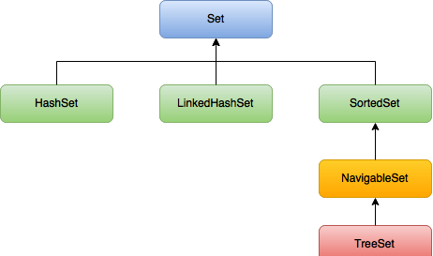
Set(I)

Slide 193
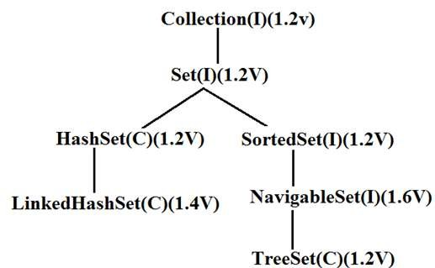

Slide 194
About Set(I)
public interface Set<E> extends Collection<E>
Set is an interface which extends Collection. It is an unordered collection of objects in which duplicate values cannot be stored.
Basically, Set is implemented by HashSet, LinkedSet or TreeSet (sorted representation).
Set has various methods to add, remove clear, size, etc to enhance the usage of this interface

Slide 195
– This class implements the Set interface, backed by a hash table (actually a HashMap instance). It makes no guarantees as to the iteration order of the set; in particular, it does not guarantee that the order will remain constant over time. This class permits the null element. This class is not synchronized. However it can be synchronized explicitly like this: Set s = Collections.synchronizedSet(new HashSet(...));

Slide 196
Difference between List and Set
List can contain duplicate elements
whereas Set contains unique elements only

Slide 197
Java HashSet class
Java HashSet class is used to create a collection that uses a hash table for storage. It inherits the AbstractSet class and implements Set interface.
The important points about Java HashSet class are:
HashSet stores the elements by using a mechanism called hashing.
HashSet contains unique elements only.

Slide 198
HashSet class declaration
– public class HashSet<E> extends AbstractSet<E> implements Set<E>, Cloneable, Serializable

Slide 199
Constructors of Java HashSet class:
Constructor HashSet()
Description
It is used to construct a default HashSet.
It is used to initialize the hash set by using the elements of the collection c.
It is used to initialize the capacity of the hash set to the given integer value capacity. The capacity grows automatically as elements are added to the HashSet.
HashSet(Collection c)
HashSet(int capacity)

Slide 200
HashSet hs=new HashSet()
Default Capacity 16
fillRatio :0.75

Slide 201
Methods of Java HashSet class:
Method
Description
void clear()
It is used to remove all of the elements from this set.
boolean contains(Object o)
It is used to return true if this set contains the specified element.
boolean add(Object o)
It is used to adds the specified element to this set if it is not already present.
boolean isEmpty()
It is used to return true if this set contains no elements.
boolean remove(Object o)
It is used to remove the specified element from this set if it is present.
Object clone()
It is used to return a shallow copy of this HashSet instance: the elements themselves are not cloned.
Iterator iterator()
It is used to return an iterator over the elements in this set.
int size()
It is used to return the number of elements in this set.

Slide 202
Java HashSet Example
import java.util.*;
class HashSetDemo{
public static void main(String args[]){
//Creating HashSet and adding elements
HashSet<String> set=new HashSet<String>();
set.add("Ravi");
set.add("Vijay");
set.add("Ravi");
set.add("Ajay");
–

Slide 203
//Traversing elements
Iterator<String> itr=set.iterator();
while(itr.hasNext()){
System.out.println(itr.next());
– } } }

Slide 204
Java LinkedHashSet class
Java LinkedHashSet class is a Hash table and Linked list implementation of the set interface. It inherits HashSet class and implements Set interface.
The important points about Java LinkedHashSet class are:
Contains unique elements only like HashSet.
Provides all optional set operations, and permits null elements.
Maintains insertion order.

Slide 205
LinkedHashSet class declaration
– public class LinkedHashSet<E> extends HashSet<E> implements Set<E>, Clonea ble, Serializable

Slide 206
Constructors of LinkedHashSet class
Constructor
HashSet()
HashSet(Collection c)
LinkedHashSet(int capacity) LinkedHashSet(int capacity, float fillRatio)
Description
It is used to construct a default HashSet.
It is used to initialize the hash set by using the elements of the collection c.
It is used initialize the capacity of the linkedhashset to the given integer value capacity.
It is used to initialize both the capacity and the fill ratio (also called load capacity) of the hash set from its argument.

Slide 207
Example of LinkedHashSet class
import java.util.*;
class LinkedHashSetDemo{
public static void main(String args[]){
LinkedHashSet<String> al=new LinkedHashSet<String>();
al.add("Ravi");
al.add("Vijay");
al.add("Ravi");
al.add("Ajay");

Slide 208
Iterator<String> itr=al.iterator();
while(itr.hasNext()){
System.out.println(itr.next());
– }
– }
– }

Slide 209
Java TreeSet class
Java TreeSet class implements the Set interface that uses a tree for storage. It inherits AbstractSet class and implements NavigableSet interface. The objects of TreeSet class are stored in ascending order.
The important points about Java TreeSet class are:
Contains unique elements only like HashSet.
Access and retrieval times are quiet fast.
Maintains ascending order.

Slide 210
TreeSet class declaration
– public class TreeSet<E> extends AbstractSet<E> implements NavigableSet<E>, Cl oneable, Serializable

Slide 211
Constructors of Java TreeSet class
Constructor
TreeSet()
TreeSet(Collection c) TreeSet(Comparator comp) TreeSet(SortedSet ss)
Description
It is used to construct an empty tree set that will be sorted in an ascending order according to the natural order of the tree set.
It is used to build a new tree set that
contains the elements of the collection c.
It is used to construct an empty tree set that will be sorted according to given comparator.
It is used to build a TreeSet that contains the
elements of the given SortedSet.

Slide 212
Methods of Java TreeSet class
Method
Description
boolean addAll(Collection c)
It is used to add all of the elements in the specified collection to this set.
boolean contains(Object o)
It is used to return true if this set contains the specified element.
boolean isEmpty()
It is used to return true if this set contains no elements.
boolean remove(Object o)
It is used to remove the specified element from this set if it is present.
void add(Object o)
It is used to add the specified element to this set if it is not already present.
void clear()
It is used to remove all of the elements from this set.
Object clone()
It is used to return a shallow copy of this TreeSet instance.
Object first()
It is used to return the first (lowest) element currently in this sorted set.
Object last()
It is used to return the last (highest) element currently in this sorted set.
int size()
It is used to return the number of elements in this set.

Slide 213
Java TreeSet Example
import java.util.*;
class TreeSetDemo{
public static void main(String args[]){
//Creating and adding elements
TreeSet<String> al=new TreeSet<String>();
al.add("Ravi");
al.add("Vijay");
al.add("Ravi");
al.add("Ajay");

Slide 214
//Traversing elements
Iterator<String> itr=al.iterator();
while(itr.hasNext()){
System.out.println(itr.next());
– }
– }
– }

Slide 215
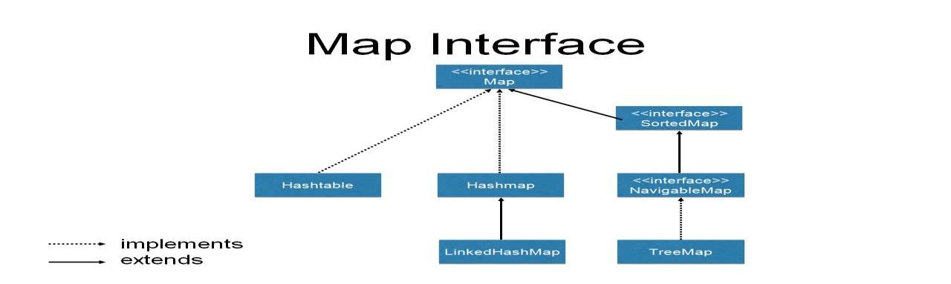
Map

Slide 216
A map contains values on the basis of key i.e. key and value pair. Each key and value pair is known as an entry. Map contains only unique keys.
Map is useful if you have to search, update or delete elements on the basis of key.

Slide 217
methods of Map interface
Method
Object put(Object key, Object value)
Description
It is used to insert an entry in this map.
void putAll(Map map)
It is used to insert the specified map in this map.
Object remove(Object key)
It is used to delete an entry for the specified key.
Object get(Object key)
It is used to return the value for the specified key.
boolean containsKey(Object key)
It is used to search the specified key from this map.
Set keySet()
It is used to return the Set view containing all the keys.
Set entrySet()
It is used to return the Set view containing all the keys and values.

Slide 218
Java Map Example: Generic (New Style)
import java.util.*;
class MapInterfaceExample{
public static void main(String args[]){
Map<Integer,String> map=new HashMap<Integer,String>();
map.put(100,"Amit");
map.put(101,"Vijay");
map.put(102,"Rahul");
for(Map.Entry m:map.entrySet()){
System.out.println(m.getKey()+" "+m.getValue());
– }
– }
– }

Slide 219
Method of Map.Entry interface
1) boolean equals(Object o): Compares the specified object with this entry for equality.
Key getKey(): Returns the key corresponding to this entry.
Value getValue(): Returns the value corresponding to this entry.
int hashCode(): Returns the hash code value for this map entry.
Value setValue(V value): Replaces the value corresponding to this entry with the specified value (optional operation).

Slide 220
Example and Usage of Map.Entry
– In this example, we have a Map collection class TreeMap and we are iterating and displaying its key & value pairs using Map.Entry interfaces. Here we have used getKey() and getValue() methods of Map.Entry interface in order to get the key & value pairs.

Slide 221
Old Style -Non-Generic
import java.util.*;
class TreeMapExample {
public static void main(String args[]) {
// Creating TreeMap object
TreeMap<String, Integer> tm = new TreeMap<String, Integer>();
// Adding elements to the Map
tm.put("Chaitanya", 27);
tm.put("Raghu", 35);
tm.put("Rajeev", 37);
tm.put("Syed", 28);

Slide 222
// Getting a set of the entries
Set set = tm.entrySet();
// Get an iterator
Iterator it = set.iterator();
// Display elements
while(it.hasNext()) {
Map.Entry me = (Map.Entry)it.next();
System.out.print("Key: "+me.getKey() + " & Value: ");
System.out.println(me.getValue());
– }
– }
– }

Slide 223
//Non-generic
import java.util.*;
public class MapExample1 {
public static void main(String[] args) {
Map map=new HashMap();
//Adding elements to map
map.put(1,"Amit");
map.put(5,"Rahul");
map.put(2,"Jai");
map.put(6,"Amit");

Slide 224
//Traversing Map
Set set=map.entrySet();//Converting to Set so that we can traverse
Iterator itr=set.iterator();
while(itr.hasNext()){
//Converting to Map.Entry so that we can get key and value separately
Map.Entry entry=(Map.Entry)itr.next();
System.out.println(entry.getKey()+" "+entry.getValue());
– }
– }
– }

Slide 225
Java HashMap class
Java HashMap class implements the map interface by using a hashtable. It inherits AbstractMap class and implements Map interface.
The important points about Java HashMap class are:
A HashMap contains values based on the key.
It contains only unique elements.
It may have one null key and multiple null values.
It maintains no order.

Slide 226
HashMap class declaration
HashMap is a Map based collection class that is used for storing Key & value pairs, it is denoted as HashMap<Key, Value> or HashMap<K, V>. This class makes no guarantees as to the order of the map. It is similar to the Hashtable class except that it is unsynchronized and permits nulls(null values and null key).
It is not an ordered collection which means it does not return the keys and values in the same order in which they have been inserted into the HashMap. It does not sort the stored keys and Values. You must need to import java.util.HashMap or its super class in order to use the HashMap class and methods.

Slide 227
HashMap
public class HashMap<K,V> extends AbstractMap<K,V> implements Map<K,V>, Cloneable, Serializable \
HashMap class Parameters
Let's see the Parameters for java.util.HashMap class.
K: It is the type of keys maintained by this map.
V: It is the type of mapped values.

Slide 228
Constructors of Java HashMap class
Constructor HashMap()
HashMap(Map m)
HashMap(int capacity)
HashMap(int capacity, float fillRatio)
Description
It is used to construct a default HashMap.
It is used to initializes the hash map by using the elements of the given Map object m.
It is used to initializes the capacity of the hash map to the given integer value, capacity.
It is used to initialize both the capacity and fill ratio of the hash map by using its arguments.

Slide 229
Exp
import java.util.*;
class HashMapDemo{
public static void main(String args[]){
HashMap<Integer,String> hm=new HashMap<Integer,String>();
– hm.put(100,"Amit");
hm.put(101,"Vijay");
hm.put(102,"Rahul");
for(Map.Entry m:hm.entrySet()){
System.out.println(m.getKey()+" "+m.getValue());
– }
– }
– }

Slide 230
LinkedHashMap in Java
– LinkedHashMap is a Hash table and linked list implementation of the Map interface, with predictable iteration order. This implementation differs from HashMap in that it maintains a doubly-linked list running through all of its entries. This linked list defines the iteration ordering, which is normally the order in which keys were inserted into the map (insertion-order).

Slide 231
HashMap doesn’t maintain any order.
•TreeMap sort the entries in ascending order of keys.
•LinkedHashMap maintains the insertion order.

Slide 232
LinkedHashMap class declaration
– public class LinkedHashMap<K,V> extends HashMap<K,V> implements Map<K,V
>

Slide 233
Constructors of Java LinkedHashMap class
Constructor
LinkedHashMap()
LinkedHashMap(int capacity) LinkedHashMap(int capacity, float fillRatio)
LinkedHashMap(Map m)
Description
It is used to construct a default
LinkedHashMap.
It is used to initialize a LinkedHashMap
with the given capacity.
It is used to initialize both the capacity and the fillRatio.
It is used to initialize the LinkedHashMap with the elements from the given Map class m.

Slide 234
Java LinkedHashMap Example(Generic)
import java.util.*;
class TestCollection14{
public static void main(String args[]){
LinkedHashMap<Integer,String> hm=new LinkedHashMap<Integer,String>();
– hm.put(100,"Amit");
hm.put(101,"Vijay");
hm.put(102,"Rahul");
–

Slide 235
for(Map.Entry <Integer,String> m:hm.entrySet()){
System.out.println(m.getKey()+" "+m.getValue());
– }
– }
– }

Slide 236
Non-generic
import java.util.LinkedHashMap;
import java.util.Set;
import java.util.Iterator;
import java.util.Map;
public class LinkedHashMapDemo {
public static void main(String args[]) {
// HashMap Declaration
LinkedHashMap<Integer, String> lhmap =
new LinkedHashMap<Integer, String>();

Slide 237
//Adding elements to LinkedHashMap
lhmap.put(22, "Abey");
lhmap.put(33, "Dawn");
lhmap.put(1, "Sherry");
lhmap.put(2, "Karon");
lhmap.put(100, "Jim");

Slide 238
// Generating a Set of entries
Set set = lhmap.entrySet();
// Displaying elements of LinkedHashMap
Iterator iterator = set.iterator(); while(iterator.hasNext()) {
Map.Entry me = (Map.Entry)iterator.next(); System.out.print("Key is: "+ me.getKey() + "& Value is: "+me.getValue()+"\n");
} }}
–
–
–
–
–
–

Slide 239
TreeMap
Java TreeMap class implements the Map interface by using a tree. It provides an efficient means of storing key/value pairs in sorted order.
The important points about Java TreeMap class are:
A TreeMap contains values based on the key. It implements the NavigableMap interface and extends AbstractMap class.
It contains only unique elements.
It cannot have null key but can have multiple null values.
It is same as HashMap instead maintains ascending order.

Slide 240
TreeMap class declaration
– public class TreeMap<K,V> extends AbstractMap<K,V> implements NavigableMa p<K,V>, Cloneable, Serializable

Slide 241
Constructors of Java TreeMap class
Constructor
TreeMap()
TreeMap(Comparator comp) TreeMap(Map m)
TreeMap(SortedMap sm)
Description
It is used to construct an empty tree map that will be sorted using the natural order of its key.
It is used to construct an empty tree-based map that will be sorted using the comparator comp.
It is used to initialize a tree map with the entries from m, which will be sorted using the natural order of the keys.
It is used to initialize a tree map with the entries from the SortedMap sm, which will be sorted in the same order as sm.

Slide 242
Methods of Java TreeMap class
Method
Description
boolean containsKey(Object key)
It is used to return true if this map contains a mapping for the specified key.
boolean containsValue(Object value)
It is used to return true if this map maps one or more keys to the specified value.
Object firstKey()
It is used to return the first (lowest) key currently in this sorted map.
Object get(Object key)
It is used to return the value to which this map maps the specified key.
Object lastKey()
It is used to return the last (highest) key currently in this sorted map.
Object remove(Object key)
It is used to remove the mapping for this key from this TreeMap if present.
void putAll(Map map)
It is used to copy all of the mappings from the specified map to this map.
Set entrySet()
It is used to return a set view of the mappings contained in this map.
int size()
It is used to return the number of key-value mappings in this map.
Collection values()
It is used to return a collection view of the values contained in this map.

Slide 243
Java TreeMap Example:
import java.util.*;
class TreeMapDemo{
public static void main(String args[]){
TreeMap<Integer,String> hm=new TreeMap<Integer,String>();
– hm.put(100,"Amit");
– hm.put(102,"Ravi");
hm.put(101,"Vijay");
hm.put(103,"Rahul");
for(Map.Entry m:hm.entrySet()){
System.out.println(m.getKey()+" "+m.getValue());
– } } }

Slide 244
Java Hashtable class
This class implements a hash table, which maps keys to values. Any non-null object can be used as a key or as a value. Hashtable is similar to HashMap except it is synchronized
Java Hashtable class implements a hashtable, which maps keys to values. It inherits Dictionary class and implements the Map interface.
The important points about Java Hashtable class are:
A Hashtable is an array of list. Each list is known as a bucket. The position of bucket is identified by calling the hashcode() method. A Hashtable contains values based on the key.
It contains only unique elements.
It may have not have any null key or value.
It is synchronized.

Slide 245
Hashtable class declaration
– public class Hashtable<K,V> extends Dictionary<K,V> implements Map<K,V>, Clo neable, Serializable

Slide 246
Constructors of Java Hashtable class
Constructor
Hashtable()
Hashtable(int size) Hashtable(int size, float fillRatio)
Description
It is the default constructor of hash table it instantiates the Hashtable class.
It is used to accept an integer parameter and creates a hash table that has an initial size specified by integer value size.
It is used to create a hash table that has an initial size specified by size and a fill ratio specified by fillRatio.

Slide 247
Methods of Java Hashtable class
Method
void clear()
Description
It is used to reset the hash table.
boolean contains(Object value)
This method return true if some value equal to the value exist within the hash table, else return false.
boolean containsValue(Object value)
This method return true if some value equal to the value exists within the hash table, else return false.
boolean containsKey(Object key)
This method return true if some key equal to the key exists within the hash table, else return false.
boolean isEmpty()
This method return true if the hash table is empty; returns false if it contains at least one key.
void rehash()
It is used to increase the size of the hash table and rehashes all of its keys.
Object get(Object key)
This method return the object that contains the value associated with the key.
Object remove(Object key)
It is used to remove the key and its value. This method return the value associated with the key.
int size()
This method return the number of entries in the hash table.

Slide 248
Java Hashtable Example
import java.util.*;
class HashtableDemo{
public static void main(String args[]){
Hashtable<Integer,String> hm=new Hashtable<Integer,String>();
– hm.put(100,"Amit");
– hm.put(102,"Ravi");
hm.put(101,"Vijay");
hm.put(103,"Rahul");
–

Slide 249
for(Map.Entry m:hm.entrySet()){
System.out.println(m.getKey()+" "+m.getValue());
– } } }

Slide 250
Difference between HashMap and Hashtable
HashMap is non-synchronized. This means if it’s used in multithread environment then more than one thread can access and process the HashMap simultaneously.
Hashtable is synchronized. It ensures that no more than one thread can access the Hashtable at a given moment of time. The thread which works on Hashtable acquires a lock on it to make the other threads wait till its work gets completed.

Slide 251
HashMap allows one null key and any number of null values.
Hashtable doesn’t allow null keys and null values.

Slide 252
HashMap
Hashtable
1) HashMap is non synchronized. It is not-thread safe and can't be shared between many threads without proper synchronization code.
Hashtable is synchronized. It is thread-safe and can be shared with many threads.
2) HashMap allows one null key and multiple null values.
Hashtable doesn't allow any null key or value.
3) HashMap is a new class introduced in JDK 1.2.
Hashtable is a legacy class.
4) HashMap is fast.
Hashtable is slow.
5) We can make the HashMap as synchronized by calling this code Map m = Collections.synchronizedMap(hashMap);
Hashtable is internally synchronized and can't be unsynchronized.
6) HashMap is traversed by Iterator.
Hashtable is traversed by Enumerator and Iterator.
Iterator in HashMap is fail-fast.
HashMap inherits AbstractMap class.
Enumerator in Hashtable is not fail-fast. Hashtable inherits Dictionary class.

